Slide 1
LSIC Excavation & Construction March Monthly Meeting
March 29th, 2023
LSIC E&C Focus Group
Athonu Chatterjee
Jibu Abraham
Sarah Hasnain
Claudia Knez
Raymond Lu
Michael Nord
Gus Terlaje
Sarah Hasnain & Jibu Abraham LSIC Excavation & Construction Focus Group Co-Facilitators

Slide 2
Agenda
LSIC Sign Ups & Call for speakers (April 18th)
LSIC Spring Meeting
Introduction to the LSIC Whitepaper: “The Path to an Enduring Lunar Presence” – Jibu Abraham & Sarah Hasnain (JHU APL)
Guest Speakers
Julian Ocampo, Senior Designer at Bjarke Ingels Group: (BIG) – Overview of the Project Olympus
Sergio Gomez & Miguel Coto, Herrero Builders – Terrestrial Outfitting Approaches & Key Technologies
Subgroup Breakouts – Discussing LSIC Whitepaper Feedback

Slide 4
LSIC | White Paper: The Path to an Enduring Lunar Presence
LSIC Excavation & Construction

Slide 5
LSIC | White Paper: The Path to an Enduring Lunar Presence
Goals for today’s LSIC Excavation & Construction White Paper Discussion:
Provide the LSIC Excavation & Construction FG an introduction the ongoing LSIC Paper effort
Highlight near-term opportunities to provide feedback on the WIP paper
FG Meetings
Spring Meeting
Engage in community discussion to provide inputs to the Excavation & Construction section of the paper (During breakouts)
“Raise Hand” in Zoom or share in chat during discussion portion
5

Slide 6
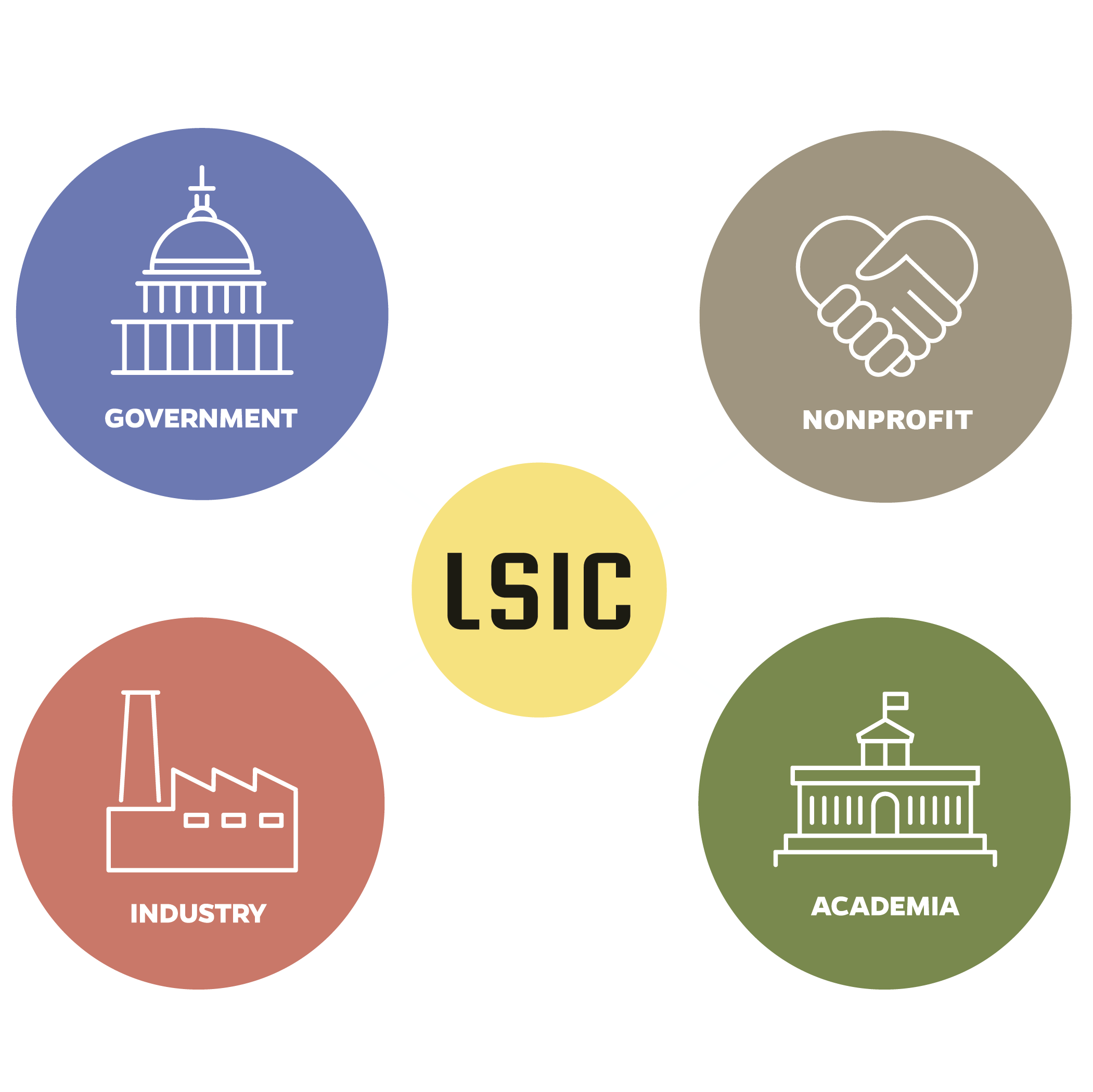
LSIC | White Paper: The Path to an Enduring Lunar Presence
Decisions we make now are critically important to achieve the 10+ year goals of the Nation on the Moon and beyond
APL with LSIC is developing a community-derived white paper on the path from early NASA missions to an Enduring Lunar Presence with a robust lunar ecosystem
“In satisfying NASA’s baseline objectives, how do we ensure robust participation from industry that also enables a transition away from NASA as a sole customer?”
Stakeholder alignment – NASA will not achieve goals alone
Phased development and key early investments/decisions
Opportunities for “systems of systems” tech demos – terrestrial or lunar
6

Slide 7
LSIC | White Paper: The Path to an Enduring Lunar Presence
Structure of the paper:
Estimated 10 pages – high level, in family with M2M Objectives and OSTP Cislunar document
Identify key infrastructure from industry’s perspective
What enables the evolution of the Moon into an exploration proving grounds?
What are the technologies that have shared applicability across all stakeholders and how do we best motivate their development?
The 6 LSII focus areas are integrated in the process – not independent efforts
What combined tech demos could retire key questions?
7

Slide 8
Transition to Industry
Transition to industry is likely to accelerate after the ARTEMIS campaign
NASA shifts focus to Mars missions (Moon to Mars)
Breaks into natural Lunar development phases
(Moon)Phase 1 – Artemis I-VIII (to 2031)
(To) Phase 2 – Artemis IX – Mars Development (2030s)
(Mars) Phase 3 – Mars Development and Lunar Operations as a service (2040s)
Highlight industry priorities throughout this process – What is important to you that needs to happen now?
Identify key gaps where NASA/OGAs need to lead
Areas for collaboration between NASA/OGA/Academia
Reference: https://www.nasa.gov/sites/default/files/atoms/files/fy23_nasa_budget_request_summary.pdf
Phase 1 (Moon)

Slide 9
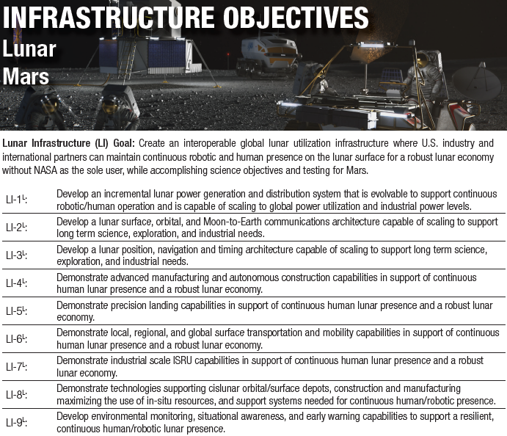
Lunar Goals
Reference: https://www.nasa.gov/sites/default/files/atoms/files/m2m-objectives-exec-summary.pdf
Moon to Mars Threshold Objectives
Support Moon to Mars
The Moon is a proving ground for Mars across all domains
Technology
Policy
Systems Engineering
Baselined on good faith interpretations of NASA’s current plans
“Desirement”
There will be a long term sustainable presence on the Moon with substantial commercial involvement – “Commercial Ecosystem”
Commercial sale of propellant
Lunar Tourism
Life off of Earth
Extended Science Operations
Off-planet field testing
Lunar Manufacturing
Mission pulls are broad here
DEVELOP: Design, build, and deploy a system, ready to be operated by the user, to fully meet architectural objectives.
DEMONSTRATE:
Deploy an initial capability to enable system maturation and future industry growth in alignment with architecture objectives.
How might industry partner and accelerate the M2M process in regards to Excavation & Construction?

Slide 10
Excavation & Construction Community Discussion
What does the State-of-the-Art (SOTA) in Excavation & Construction need to be for a sustained lunar presence when NASA pivots from Moon to Mars? (Phase 2)
Gaps: What Excavation & Construction technology, requirements/guidelines, etc. do we need for Phase 2 that does not exist or is not planned right now?
Ensure there is a clear business strategy for lunar development
Autonomous construction & Fully Automated construction
Digital twining and detailed environmental models that can be shared from NASA.
Opportunities: How might we bridge these gaps?
Stakeholder Engagement: Who should be communicating, collaborating, etc. but isn’t (yet!)?
Genie: 1) Mobile nuclear reactors; 2) advanced construction vehicles which can overcome issues such as regolith abrasion/electrostatic interference, mass/anchor needs to actually excavate, easily replaceable components
How might industry partner and accelerate the M2M process in regards to Excavation & Construction?
What is important to you that needs to happen now?
Ensuring there is industry input solicited early in the planning and design process
Leverage terrestrial construction guidelines and subsystem guidelines

Slide 11
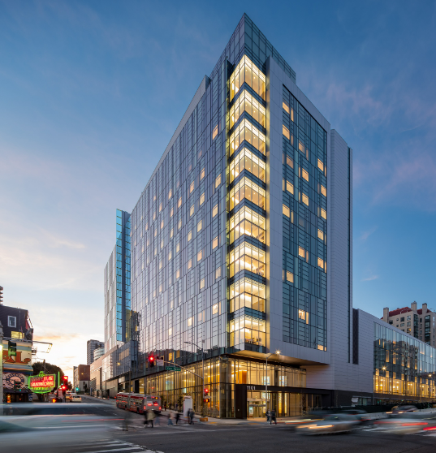
Sergio Gomez & Miguel Coto / Herrero Builders
Sergio Gomez graduated in 2016 with a Bachelor’s degree in Mechanical Engineering from San Francisco State University. Sergio has 6.5 years of experience working as an MEP Project Manager for Herrero Builders in San Francisco, where he specializes in MEP systems for healthcare projects. Sergio has worked on some of the biggest healthcare projects in the San Francisco Bay Area that add to a total of $5.5B in project budgets, close to 1.97 million sqft. His current project is a ground up hospital with state of the art research equipment for the University of California in San Francisco.
Miguel Coto holds a Bachelor’s degree in Mechanical Engineering from San Francisco State University and a Master’s degree in Space Resources from Colorado School of Mines. Miguel has 3.5 years of experience working as an MEP Project Engineer for Herrero Builders in San Francisco specializing in MEP systems for healthcare projects. His last project was a $450M expansion wing for a hospital in Santa Rosa, CA which he did along with Sergio. Miguel is also leading the outfitting subgroup of the E&C LSIC group.

Slide 12
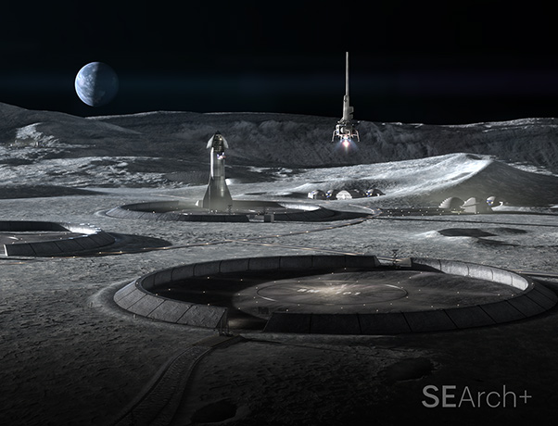
Julian Ocampo Salazar / Bjarke Ingels Group
Julian is a Senior Designer at BIG where he specializes in additive manufacturing and digital fabrication leading much of BIG’s Space and 3D printed related work. Most recently Julian led the design teams behind Project Olympus, humanity's first permanent construction outside planet earth, and Mars Dune Alpha, a 3D printed habitat completed at the Johnson Space Center in 2022. The structure simulates a realistic Mars habitat which supports long-duration space research missions. Both projects were designed in association with NASA and ICON Technology.
Prior to joining BIG, Julian spent half a decade working with different design studios around the world, including Diller Scofidio + Renfro in New York City, MVRDV in Rotterdam and SelgasCano in Madrid. He holds a Master of Architecture from the Massachusetts Institute of Technology and a Bachelor of Architecture degree from the University of Waterloo.

Slide 13
Breakouts

